Slide 1
Table booking system
Developed by:
Aaryan dubey-16010123011
Aarya shevale-16010123009

Slide 2
Project Overview
Problem Statement: Managing restaurant reservations efficiently is difficult due to increasing customer demands and limited seating.
Solution: A web-based table booking system that allows users to:
Reserve tables in real-time with ease
Receive booking confirmations and reminders securely

Slide 3

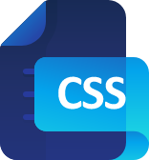

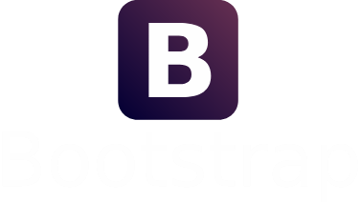


Technology Stack
Frontend:
HTML5, CSS, Bootstrap
JavaScript
Backend:
PHP
MySQL Database
XAMPP as development environment
Additional Libraries:
Bootstrap
Font Awesome icons

Slide 4
Database Schema
Table: tbladmin
ID (Primary Key, Auto Increment)
AdminName (VARCHAR, 120)
AdminuserName (VARCHAR, 20)
MobileNumber (BIGINT, 10)
Email (VARCHAR, 120)
Password (VARCHAR, 120)
AdminRegdate (TIMESTAMP, Default: CURRENT_TIMESTAMP)
UserType (INT, 1)

Slide 5
Database Schema
Table: tblbookings
ID (Primary Key, Auto Increment)
BookingNo (BIGINT, 12)
FullName (VARCHAR, 200)
EmailId (VARCHAR, 200)
PhoneNumber (BIGINT, 12)
BookingDate (DATE)
BookingTime (VARCHAR, 100)
NoAdults (BIGINT, 20)
NoChildrens (BIGINT, 20)
TableId (INT, Foreign Key to tblrestables.ID)
AdminRemark (VARCHAR, 255)
BookingStatus (VARCHAR, 15)
PostingDate (TIMESTAMP, Default: CURRENT_TIMESTAMP)
UpdationDate (TIMESTAMP, Updates on modification)

Slide 6
Database Schema
Table: tblrestables
ID (Primary Key, Auto Increment)
TableNumber (VARCHAR, 100)
CreationDate (TIMESTAMP, Default: CURRENT_TIMESTAMP)
AddedBy (INT, Foreign Key to tbladmin.ID)

Slide 7

Future Enhancements
AI-Powered Reservations – Implement machine learning to suggest optimal booking times based on past trends and real-time restaurant occupancy.
· Automated Waitlist System – Introduce a smart waitlist that notifies users when a table becomes available.
· Seamless Payment Integration – Allow users to pay for bookings in advance or split bills digitally through payment gateways.
· Loyalty & Rewards System – Offer discounts, rewards points, or personalized offers based on frequent bookings.
· Voice & Chatbot Assistance – Enable table reservations via voice commands or AI-powered chatbots for a smoother booking experience.
· Multi-Restaurant Support – Expand the system to allow booking across multiple restaurants with unified management.
· Customizable Dining Preferences – Let users specify preferences such as seating location, ambiance, or dietary requirements.
· Social Media & Review Integration – Link booking experiences with social media sharing and real-time reviews.
· Advanced Analytics for Restaurants – Provide insights into peak hours, customer demographics, and booking patterns for better decision-making.
· Mobile App Development – Launch dedicated Android and iOS apps for seamless booking and notifications.

Slide 8
Conclusion
Summary of key features
User benefits:
Better convenience
Improved service as it becomes easy to manage

Slide 9
References
Bootstrap Documentation
PHP & MySQL References

